Slide 1
LLM on a Enterprise Corpus
Using Vertex PaLM and Matching Engine
Shivaji Dutta

Slide 2
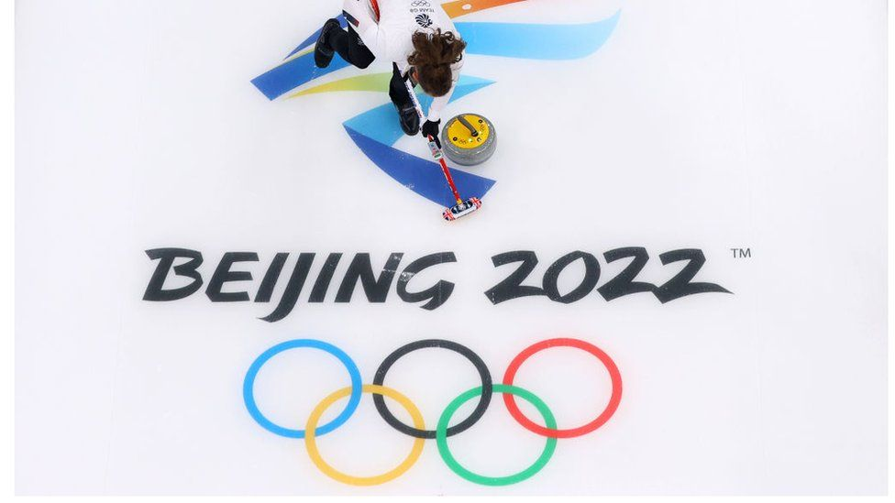
Steps to Build the System
Data Processing
Embedding Generation and Storage
Runtime Query
Context Building
Prompt Building
Execute Prompt on Vertex PaLM API
Demo Data used in Winter Olympics 2022

Slide 3
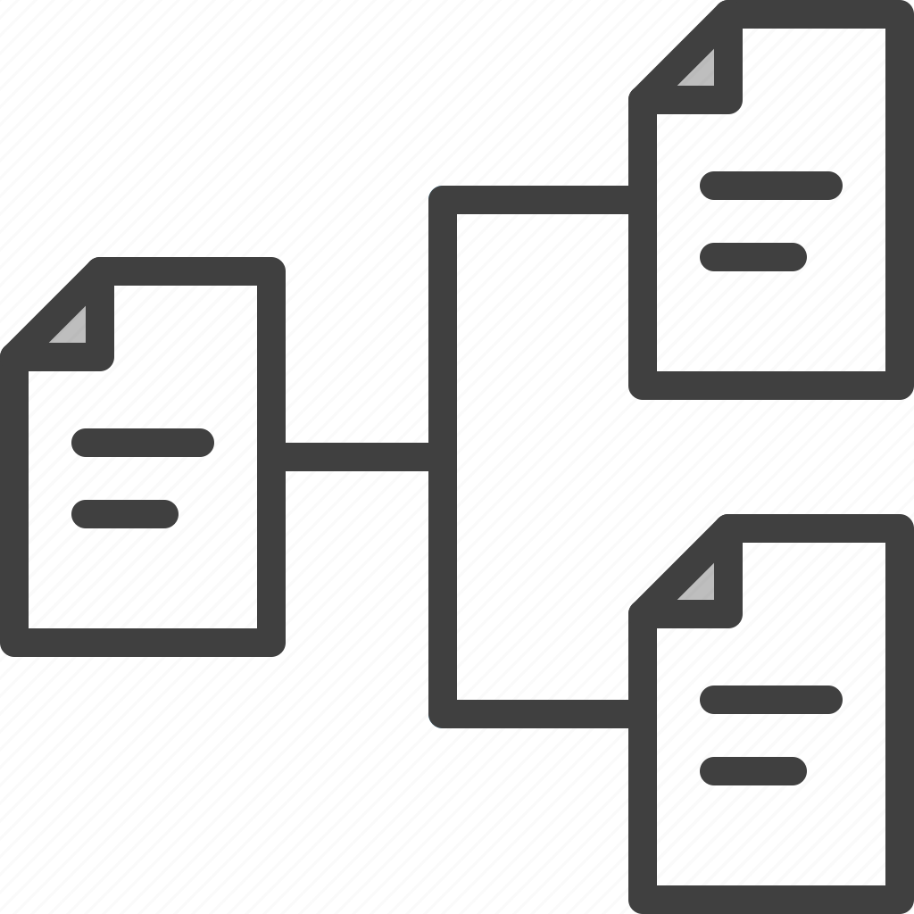


Data Preprocessing
wikipedia.com
Crawl (Winter Olympics 2022)
Chunk the documents
Save the Chunked Docs

Slide 4


Embedding Generation
Vertex AI
Vertex AI
Palm Embedding
Matching Engine (ME)
Chunked Text
Embedding File in GCS for Index Creation
Embeddings and Text are soft linked by ids in Bigtable and ME
Cloud Bigtable
BigTable (Store the Text, matching the ME id)

Slide 5

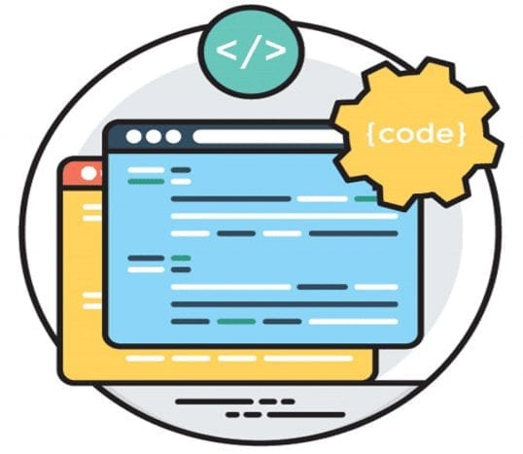

Runtime System Interaction for Q/A on WikiPedia Corpus
Vertex AI
2. Generate Emb for Q.
Palm Embedding
3. Return Emb for Q.
1. Question (Q)
3. Query ME for Matches
Vertex AI
9. Format & Return Answer
4. Return Matching Doc ids
Matching Engine (ME)
7. Build and send Prompt
User: Asks Questions
E.g. List the winners for 2022 Winter Olympcs?
8. Text response
5. Lookup the Matching text
6. Return the Texts for the ids
Vertex AI
Palm Text API
Cloud Bigtable

